Slide 1
The Rise of Socialism

Slide 2
Lesson Plan
Welcome Magister
Lesson plan
The Question of today
Industrial Revolution in the Netherlands
Social Issue
Recap (notes)
Homework
Ending
Introduction
Lesson plan
The Question
Revolution
Social Issue
Recap (notes)
Homework
Ending

Slide 3
Lesson Goals
Introduction
Lesson plan
The Question
Revolution
A mighy France
Recap (Notes)
Homework
Ending
The question of today is:
Who were committed to improving the social position of the lower class?

Slide 4
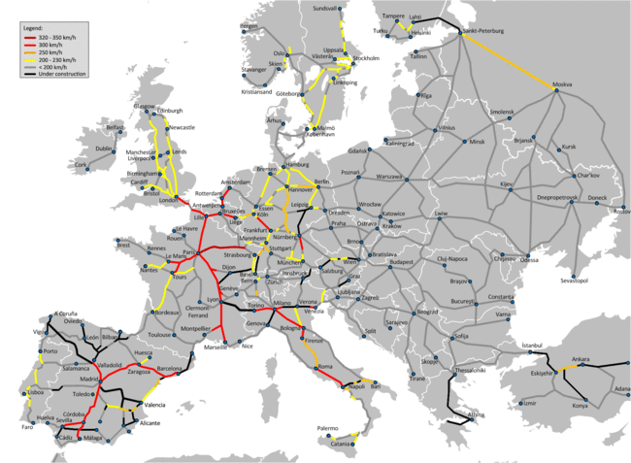
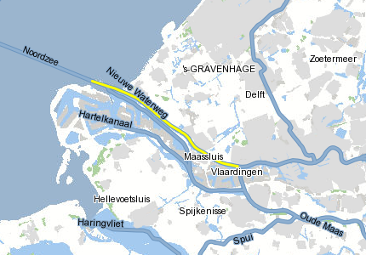
Industrial Revolution in the Netherlands
The start of the industrialisation in the Netherlands
1850-1890 : Mainly Textile and Agriculture;
From 1890 the Heavy industry starts to develop;
Construction of waterways improve trade in harbor cities like Rotterdam;
Construction of railways stimulated trade with Germany;
Coal mines in Limburg stimulated the industry even more;
Introduction
Lesson plan
The Question
Revolution
Social Issue
Recap (Notes)
Homework
Ending

Slide 5
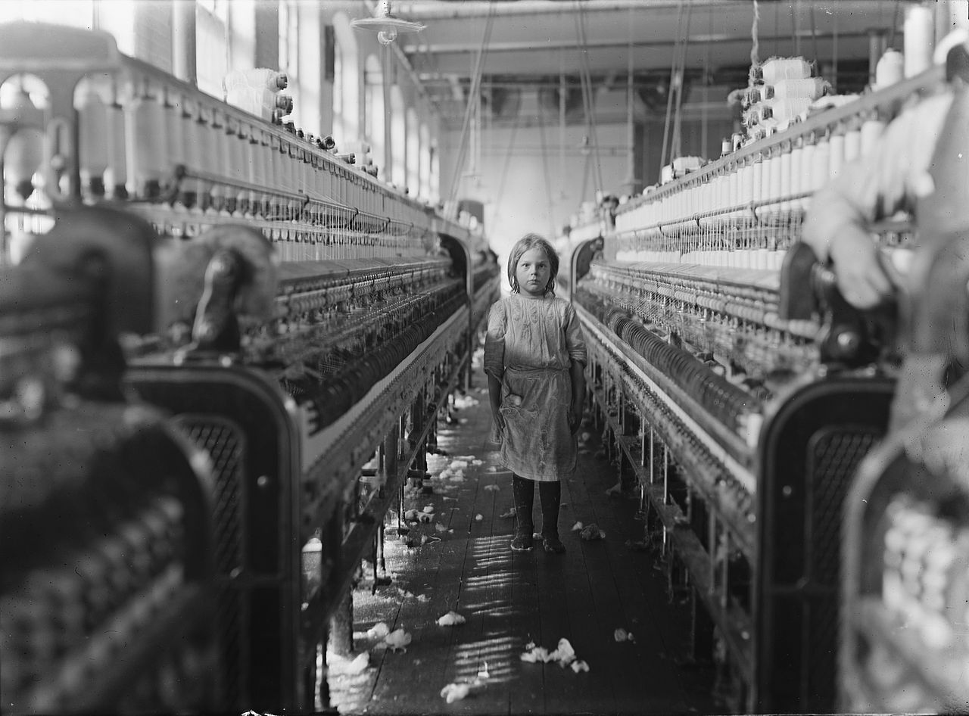
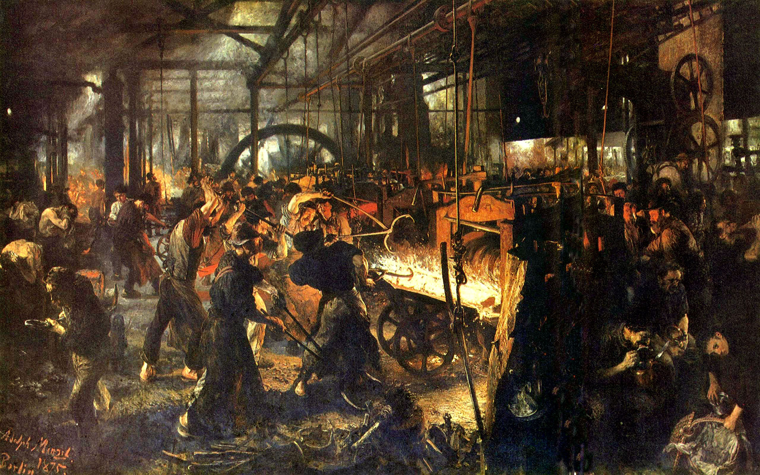
Social Issue
Socialism vs Capitalism
Trade grew, profits grew however….
Introduction
Lesson plan
The Question
Revolution
Social Issue
Recap (Notes)
Homework
Ending

Slide 6
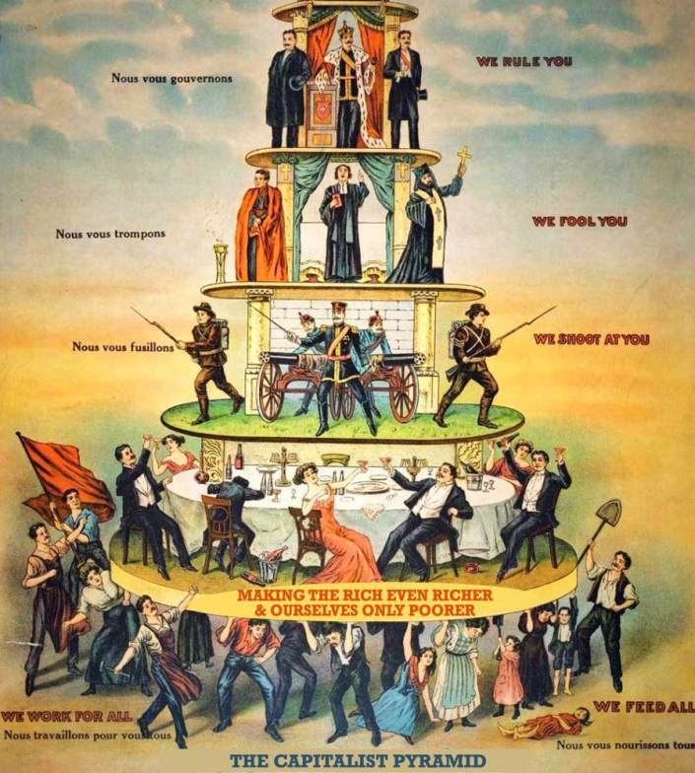
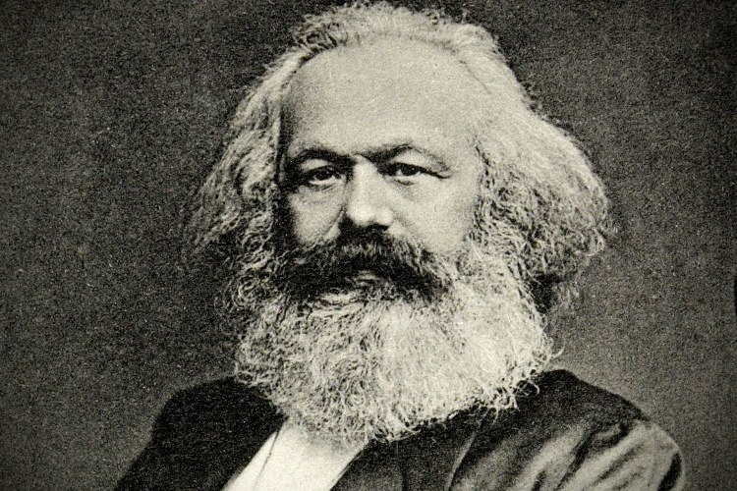
Social Issue
Socialism vs Capitalism
A new class emerged: Labourers (Proletariat)
1848: Limited Suffrage (Bourgeoisie)
Karl Marx
Introduction
Lesson plan
The Question
Revolution
Social Issue
Recap (Notes)
Homework
Ending

Slide 7
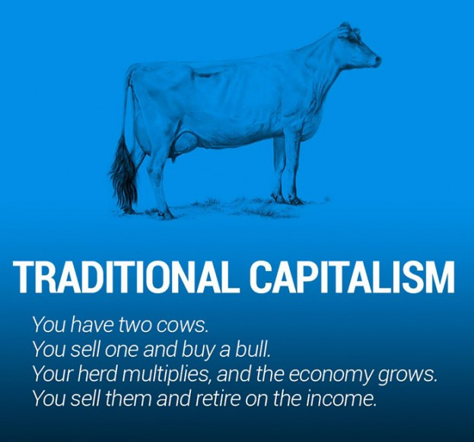
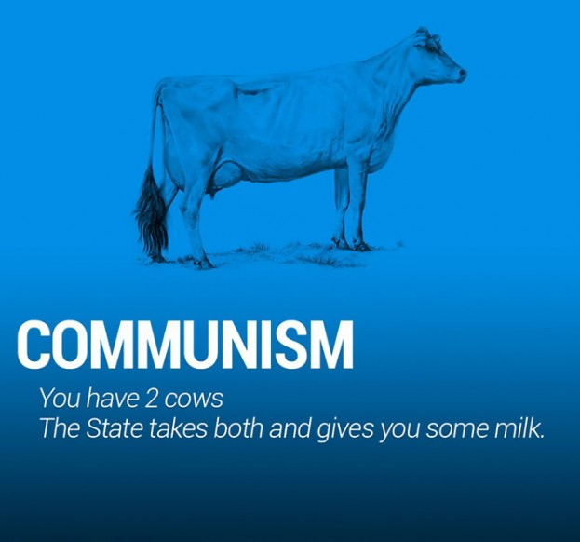
Social Issue
Communism by Karl Marx:
Labourers would start a revolution against the Bourgeoisie and take over;
Everything would belong to the state and shared equally; (No more rich and poor)
There would be a classless society;
However some believed in democracy and wanted to influence the position of Labourers by laws.
These are called Social Democrats
Introduction
Lesson plan
The Question
Revolution
Social Issue
Recap (Notes)
Homework
Ending

Slide 8
Social Issue
Question 1:
What kind of examples do you see of socialism/communism?
Assignment.
What: Watch the clip
How: Watch the clip quietly;
Help: No help;
Time: 2 minutes for the clip, 3 minutes to prepare
Finished: Start with the Questions: 4.5: Make questions 1 until 7
Result: Short class discussion (5-10 minutes)
Question 2:
What would you have done if you were a labourer?
Introduction
Lesson plan
The Question
Revolution
Social Issue
Recap (Notes)
Homework
Ending
Question 1:
What would you have done if you were a factory owner?
Rules of engagement:
Let others finish;
Raise your hand if you want to speak;
Respect other opinions;
Use facts;
Attack the message not the messenger;

Slide 9
Recap (Notes)
Worksheet
Make the worksheet
Finished? Ask for the anwser sheet and continue making questions 1 until 7
The question of today is:
Who were committed to improving the social position of the lower class?
Thanks to the social issue there was a class struggle by the labourers (proletariat) against the Bourgeoisie (Capitalists).
A movement came together to fight for the rights of the Laboureres. This was called socialism. Karl Marx wrote a book about the class struggle and thought that the labourers would start a revolution and take over.
Some poeple wanted to influence the position through the parliament. They are called Social Democrats.
In 1872 the parliament decided that labourers could set up trade unions;
In 1874 the parliament decided child labor would be restriced, this was the first social law;
In 1901 the parliament decided there would be a 45 hour work week and 8 hour work day;
Introduction
Lesson plan
The Question
Revolution
Social Issue
Recap (Notes)
Homework
Ending

Slide 10
Homework
Anwsers of the worksheet:
1. Trade Unions campaign for higher wages, shorter working hours and other improvements
2. In the picture you see children in the factory. Citizens protested against this and in 1874 the Lower House accepted a law that restricted child labor. This was known as the first social law in the Netherlands.
3. 45 hour work week and an 8 hour work day.
Homework:
Learn 4.5
make questions 1 until 7
Introduction
Lesson plan
The Question
Revolution
Social Issue
Recap (Notes)
Homework
Ending

Slide 11
Ending
What Sticks?
Next week: The Rise of Socialism

